Slide 1
Bug in SSH Protocol

Slide 2
1)- When we get remote access of a kali machine using the SSH service, The SSH needs to be turned on otherwise the connection gets refused.
2)- After successfully getting the remote access of the kali machine, If we turn off the SSH on kali machine, We are still able to access the kali machine and we have access to all the files on the kali machine.

Slide 3
Operating systems used:-
1)- Kali Linux
2)- Windows 10 pro
Machines used:-
1)- Kali Linux is running on Oracle virtual box(Through the OVA File)
2)- Windows is running on bare metal on Dell inspirion 15 (Intel core i3 7th generation)

Slide 4
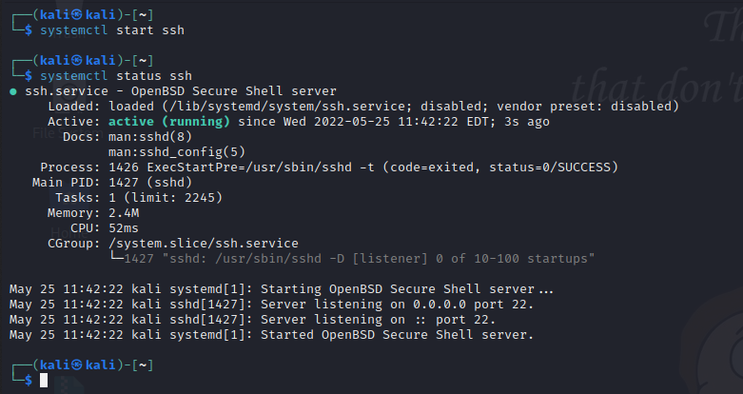
SSH Protocol is active on the kali Linux machine

Slide 5
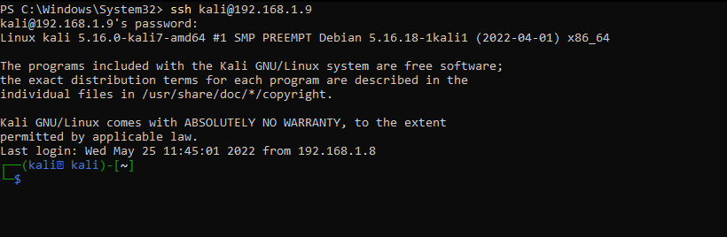
Gained remote access on the other machine (In this case we are using windows machine but it works same for other kali Linux machine too.

Slide 6
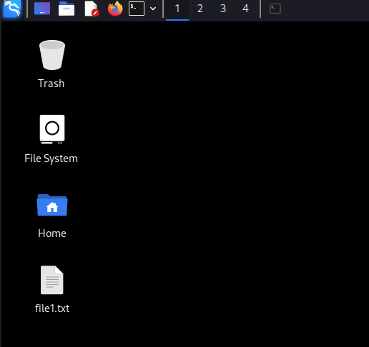
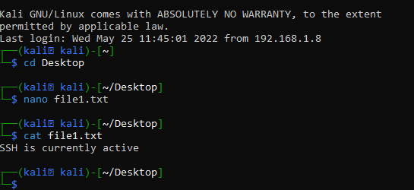

Created a file through the remote login on the desktop to verify if the remote login is working.
Hence, We can see the file was created on the desktop.
Remote Login Verified

Slide 7
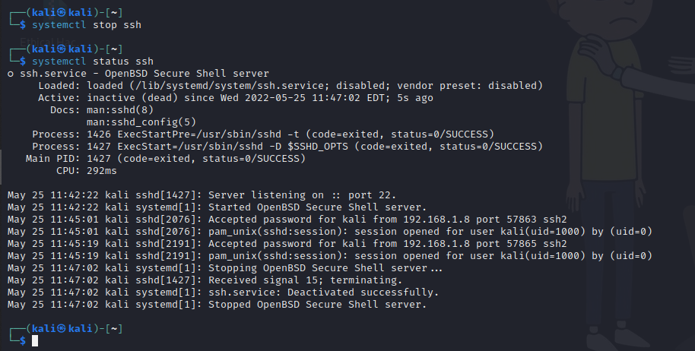
SSH is now inactive on the kali machine

Slide 8
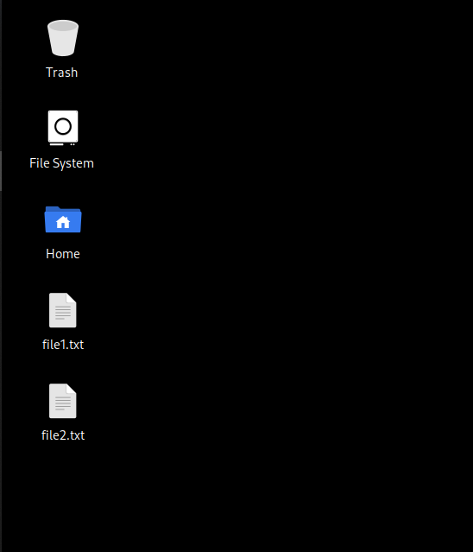
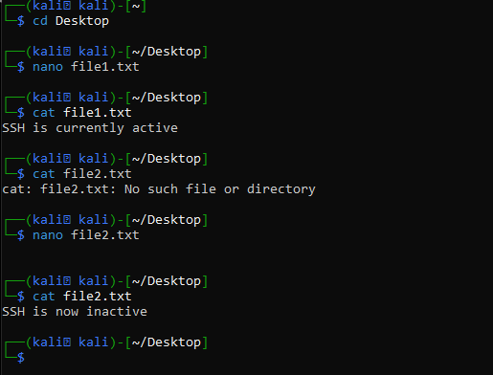
Even after the
SSH was inactive, the file was still created through the remote login. Hence, We can access the system even after turning off the ssh.

